Slide 1
Residual Nets (ResNet)
Performance
Architecture
Residual Block
BatchNormalization
GlobalAveragePooling
ResNet Design
Functional API of TensorFlow
Program for Cifar10

Slide 2
ResNet : Kaiming He, Xiangyu Zhand et al. (殘差網路), used in ChatGPT, Transformer, Bert etc.
y=ReLu(x + W₂ ReLu(W₁x))

Slide 3
Performance
ResNet first appeared in 2015’s ImageNet contest. Significantly outperformed all the other models using 152 layers architecture.
The first model that overcome the degradation problem.
Degradation problem: performance improves as the number of hidden layers increases. But up to a number of hidden layers, the performance starts to decrease. Therefore, cannot train CNN with too many layers.
Proposed to use the Residual block to solve the problem.
Notes:
ResNet 首次出現在 2015 年的 ImageNet 競賽中。顯著優於使用 152 層架構的所有其他型號。 第一個克服退化問題的模型。 降級問題：性能隨著隱藏層數的增加而提高。但是在一些隱藏層中，性能開始下降。 因此，不能用太多的層來訓練CNN。 建議使用殘餘塊來解決問題。

Slide 4
Architecture
Conv layer
16 3X3 filters
Residual Block
$$⋮$$
Here, use 54
Residual Blocks
Feature extraction
Explain later
BatchNormalization
ReLU
GlobalAveragePooling
Dense
10
softmax
Classification

Slide 5
Residual Block
A shortcut connections between two conv. layers
X
conv
conv
shortcut
ReLU
ReLU
conv
conv
ReLU
X
Add
ReLU
A conv. block
A Residual block

Slide 6
X
conv
shortcut
ReLU
conv
X_B
X
X
Add
X+X_B
ReLU
Shortcut means that conv result ADD original input denoted by X_B

Slide 7
Concept of residual
Residual is the conv(X) – X; that is, the result of X after conv minus the original X.
The rational is that, if the previous layers have already learned very well, this layer learns nothing! However, by adding the shortcut, we haven’t forgot the original details even though we haven’t learn any new features. So adding this layers doesn’t deteriorate the performance!
Notes:
殘差是 conv（X） – X;
也就是說，轉換后 X 減去原始 X 的結果。 理由是，如果前幾層已經學得很好，那麼這一層什麼也沒學到！
但是，通過添加快捷方式，即使我們沒有學習任何新功能，我們也沒有忘記原始細節。
因此，添加此圖層不會降低性能！

Slide 8
Design of residual block
X
Conv
16 1X1 filters
shortcut
ReLU
Conv
16 3X3 filters
X_B
ReLU
Conv
64 1X1 filters
Add
Design of the residual block reduces the required training time.

Slide 9
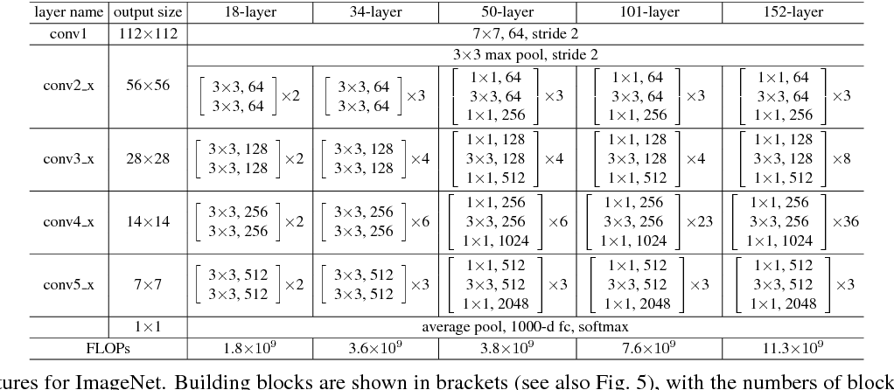
ResNet architectures
Different number of layers have different architectures; 18-layer and 34-layer have the same structure. The others
have another same structure.
Residual block which has the same filter dimensions is called “Plain architecture”;
Residual block which has different filter dimensions is called “Bottleneck architecture” .
Our example is adapted from 50—layer structure. Therefore, it as the bottleneck architecture.

Slide 10
BatchNormalization
A layer in between the conv layer and the activation layer
To transform the feature map to standard normal distribution, mean = 0 and standard deviation = 1.
To ease the training and prevent overfitting.
Better than the dropout layer, and cannot be used with the dropout layer.

Slide 11

GlobalAveragePooling2D
To average pooling a channel of a multi-channel feature map to a number
GlobalAveragePooling2D can be used to replace the flatten layer
Map A average pooled to the red node
A
A 1-dimensional array to the next dense layer
B
Map B average pooled to the blue node

Slide 12
Functional API
We have sequential and functional API in TensorFlow (or Keras) layer structure
Input
Input
Input
layer
layer
layer
classification
regression
layer
layer
merge
output
output
output
output
Sequential
Multiple output
Non-linear

Slide 13
Sequential
model = sequential()
model.add(Dense(256, activation= ‘Sigmod’, intput_shaple(784,)))
model.add(Dense(128, activation=‘Sigmod’))
model.add(Dropout(rate=0.5))
model.add(Dense(10, activation=‘softmax’))
Functional API
input = Input(shape=(784,))
x=Dense(256, activation= ‘Sigmod’)(input)
x=Dense(128, activation=‘Sigmod’)(x)
x=Dropout(rate=0.5)(x)
x==Dense(10, activation=‘softmax’)(x)
model Model(inputs=input, outputs=x)
Input shape must be specified at input
Using x as thread to link output to the input of the next layer
Use model to specify the whole model including input and output

Slide 14
Residual block A
BatchNormalixation
ReLU
Conv
BatchNormalixation
ReLU
Conv
BatchNormalixation
ReLU
Conv
Add

Slide 15
Residual block B
BatchNormalixation
ReLU
Conv
BatchNormalixation
ReLU
Conv
BatchNormalixation
ReLU
Conv
Add

Slide 16
The model
Residual Block A (16,1,1 ->16,3,1->64,1,1) X 1
Residual Block B (16,1,1 ->16,3,1->64,1,1) X 17
Residual Block A (32,1,2 ->32,3,1->128,1,1) X 1
Residual Block B (32,1,1 ->32,3,1->128,1,1) X 17
Residual Block A (64,1,2 ->64,3,1->256,1,1) X 1
Residual Block B (64,1,1 ->64,3,1->256,1,1) X 17
Note that conv(16, 1,1): 16---number of filters, 1---filter dim., 1---step size

Slide 17
# Block A
def first_residual_unit(filters, strides):
def f(x):
# → BN → ReLU
x = BatchNormalization()(x)
x_b = Activation('relu')(x)
# conv → BN → ReLU
x = conv(filters // 4, 1, strides)(x_b)
x = BatchNormalization()(x)
x = Activation('relu')(x)
# conv → BN → ReLU
x = conv(filters // 4, 3)(x)
x = BatchNormalization()(x)
x = Activation('relu')(x)
# conv→
x = conv(filters, 1)(x)
# adjust shape
x_b = conv(filters, 1, strides)(x_b)
# Add
return Add()([x, x_b])
return f
Residual block A
BatchNormalixation
ReLU
Conv
BatchNormalixation
ReLU
Conv
BatchNormalixation
ReLU
Conv
Add

Slide 18
# Block B
def residual_unit(filters):
def f(x):
x_b = x
# → BN → ReLU
x = BatchNormalization()(x)
x = Activation('relu')(x)
# conv→ BN → ReLU
x = conv(filters // 4, 1)(x)
x = BatchNormalization()(x)
x = Activation('relu')(x)
# conv→ BN → ReLU
x = conv(filters // 4, 3)(x)
x = BatchNormalization()(x)
x = Activation('relu')(x)
# conv→
x = conv(filters, 1)(x)
# Add
return Add()([x, x_b])
return f
Residual block B
BatchNormalixation
ReLU
Conv
BatchNormalixation
ReLU
Conv
BatchNormalixation
ReLU
Conv
Add

Slide 19
Construct block A×1 Block B×17
def residual_block(filters, strides, unit_size):
def f(x):
x = first_residual_unit(filters, strides)(x)
for i in range(unit_size-1):
x = residual_unit(filters)(x)
return x
return f

Slide 20
# input shape
input = Input(shape=(32,32, 3))
# conv
x = conv(16, 3)(input)
# Residual x 54
x = residual_block(64, 1, 18)(x)
x = residual_block(128, 2, 18)(x)
x = residual_block(256, 2, 18)(x)
# → BN → ReLU
x = BatchNormalization()(x)
x = Activation('relu')(x)
# Pooling
x = GlobalAveragePooling2D()(x)
# Dense
output = Dense(10, activation='softmax', kernel_regularizer=l2(0.0001))(x)
Construct model
model = Model(inputs=input, outputs=output)
Block A(16,1,1->16,3,1->64,1,1) X 1
Block B(16,1,1->16,3,1->64,1,1) X 17
Block A(32,1,2->32,3,1->128,1,1) X 1
Block B(32,1,1->32,3,1->128,1,1) X 17
Block A(64,1,2->64,3,1->256,1,1) X 1
Block B(64,1,1->64,3,1->256,1,1) X 17

